Slide 1
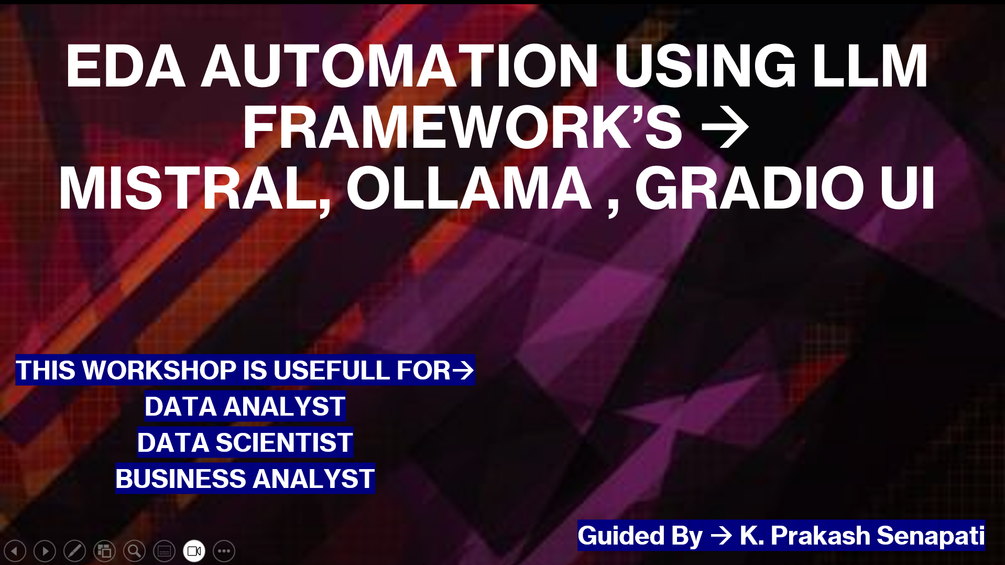

Slide 2
AGENDA ➔
1- My Introduction →
https://www.linkedin.com/in/kodi-prakash-senapati-a95a60182/
2- Introduction to EDA →
youtube.com/watch?v=tTT7XJO30cM&t=7557s
3- Introduce to LLM Model →
youtube.com/watch?v=v0w9LXXrsys&t=5404s
4- End-End Project →
Ollama, Mistral, Gradio UI
5- Gen AI, Agentic AI, FSDS New Batch Schedule→
Meeting Id: 2519 342 3910 & Password: 112233
6- Existing Workshop Link→

Slide 3
WHAT IS EDA ?
EDA (Exploratory Data Analysis) is the process of analyzing and visualizing a dataset to understand its characteristics before applying any machine learning models or statistical techniques.
It helps identify patterns, relationships, missing values, and anomalies in the data.
Python Libraries: Pandas, Matplotlib, Seaborn, Plotly

Slide 4

Key Steps in EDA→
Understanding the Data→ Load the dataset and check its structure using .head(), .info(), and .describe().
Handling Missing Values→ Identify and treat missing values using .isnull().sum().
Checking Data Types→ Ensure data types are appropriate for analysis.
Identifying Outliers→ Use box plots to detect anomalies.
Visualizing Data→ Use histograms, scatter plots, heatmaps, and pair plots to explore relationships.
Feature Correlation→ Analyze how features are related using correlation matrices.
Feature Engineering → Create new meaningful features from existing ones.

Slide 5
LLM (LARGE LANGUAGE MODEL)
Company | LLM Name
OpenAI | GPT-4.5
Anthropic | Claude 3.7 Sonnet
Google DeepMind | Gemini 2.0 Pro
Alibaba | Qwen 2.5-Max
Deep Seek | DeepSeek R1
Meta AI | Llama 3.1
Mistral AI | Mistral Large 2
Mistral AI | Mixtral 8x22B
Nvidia | Nemotron-4
Microsoft | Phi-3
Cohere | Command R
xAI | Grok-1

Slide 6

Project →
Programming Language → Python
Python Concept → Loops & Function
IDE → Vs Code
Ollama → Build LLM locally
LLM Model → Mistral AI
Frontend UI → Gradio UI
Dataset → Titanic Dataset
GitHub link→ https://github.com/kodigitaccount/EDA_INTEGRATION_LLM

Slide 7
Ollama→
Ollama is a tool that lets you run Large Language Models (LLMs) locally on your computer.
It is designed for easy deployment and management of open-source LLMs like Llama 2, Mistral, Gemma, Deeseek and more without needing a cloud-based API.
Key Features of Ollama →
✅ Run LLMs Locally – No internet required after installation. ✅ Supports Open-Source Models – Llama 2, Mistral, Gemma, Phi-2, etc. ✅ Optimized Performance – Uses GPU acceleration for fast inference. ✅ Simple Installation & API – Easy to use in apps or command-line. ✅ Fine-Tuning Support – Customize models for specific tasks.
ollama → ollama list → ollama pull mistral → ollama run mistral

Slide 8
Gradio UI →
Gradio UI is a simple way to create interactive web applications for machine learning models using Python.
It allows users to easily build and share AI-powered interfaces with just a few lines of code.
How to Install Gradio ➔ pip install gradio

Slide 9

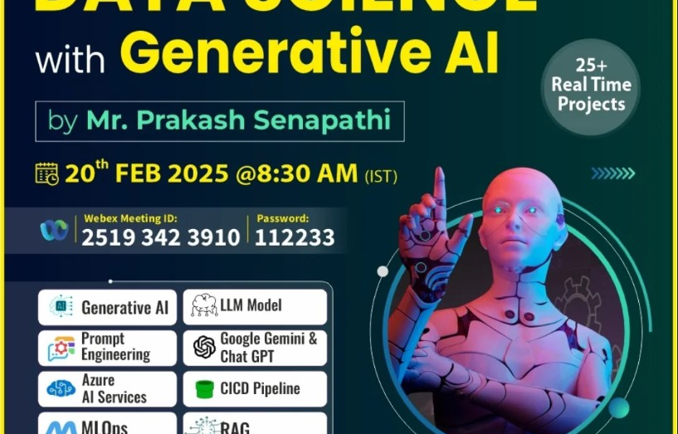
New Batch Schedule→
👉 Backup Video→
📂Day-1 https://youtu.be/fI13-OYNmcw
📂Day-2 https://youtu.be/gStlVJp8T4Q
📂Day-3: https://youtu.be/ZEsk_lMmt8s
📂Day-4: https://youtu.be/0mkDESyaY0U
📂Day-5 https://youtu.be/_JF-dQQVQuI
📂Day-6 https://youtu.be/jzMIbZmfgAg
📂Day-7 https://youtu.be/Hd_y2kxIlNk
Meeting Id: 2519 342 3910
Password: 112233

Slide 10
Previous workshop videos
ChatGPT → https://www.youtube.com/watch?v=SDStCnlITT8
Generative AI Workshop → https://www.youtube.com/watch?v=Xp1MnygECUs
LARGE LANGUAGE MODEL → https://www.youtube.com/watch?v=v0w9LXXrsys
Gen AI with Langchain, OpenAI & LLMops → https://www.youtube.com/watch?v=MAkXifYHnuw&t=1320s
Google Generative AI | Gemini AI→ https://www.youtube.com/watch?v=BDrXdvNh19Q&t=5684s
LLM Model Using Lama 3,Hugging Face & Ollama → https://www.youtube.com/watch?v=eDN6fAWLNNE&t=5425s
GEMMA-9B Integration with GROQ, HUGGINGFACE → youtube.com/watch?v=Bp1XyvMvedg&t=7086s
NLP→ https://www.youtube.com/watch?v=s-xhKH-e8ig&t=5844s
RAG→ https://www.youtube.com/watch?v=8nWjvn8ZKtU&t=7553s
AGENTIC AI_PART-1 || CREW AI→ https://www.youtube.com/watch?v=0gqlrw-6I0s
STABLE DIFFUSION → https://www.youtube.com/watch?v=LR2r3QR_SD8&t=8273s
prompt engineer(part-1) → https://www.youtube.com/watch?v=2n-RIgSNnwQ&t=8628s
prompt engineer(part-2) → https://www.youtube.com/watch?v=HvqtHmeblvQ&list=PLVlQHNRLflP81c99eg7UhkVZxwPvhTddM&index=39
Deepseek → https://www.youtube.com/watch?v=ai-v9KNUZ1Q&t=6088s
AGENTIC AI → https://www.youtube.com/watch?v=cFYyQn5Mohc
Eda_LLM (mistral, ollama, Gradio)→ https://www.youtube.com/watch?v=NM8XwKw-d7k

Slide 11
